Slide 1
Welcome to
RMSS
FIRESIDE
outdoor
education
program

Slide 2
What is Outdoor Education?
an active, experience-based, and creative approach to learning.
learning consists of practical technical skills, healthy living, informed decision-making, conflict resolution, environmental awareness and appreciation, creative problem solving, and leadership.
Individual and group skills are a focus and developed in a meaningful and creative manner.

Slide 3
What is FIRESIDE?
The FIRESIDE outdoor education program at RMSS is a two credit program established in recognition of the value and importance of outdoor education experiences. This co-ed, hands-on, group oriented and self-contained program combines in-class learning with outdoor experiential learning, so that intensive, safe, and enjoyable learning experiences can occur outdoors in natural settings. Students will collaborate with community partners and organizations to build empathy towards the environment while completing senior curriculum. This program, in conjunction with community, industry, and educational partnerships will help foster environmental awareness and promote lifelong environmental stewardship.

Slide 4
What credits can I earn?
The FIRESIDE program offers two senior level courses applicable for all pathways:
PAD 3O Outdoor Education-
Phys Ed. Curriculum
IDC 3O Interdisciplinary Studies – Environmental Education

Slide 5
Course Objectives?
To provide opportunities to develop an understanding of the interrelationships in the natural world and an awareness of how we affect, and are affected by, the environment.
To provide a unique dimension for the promotion and encouragement of independence, resourcefulness, flexibility, creativity, ingenuity and problem solving.
To develop an appreciation of the patterns, structure, and interdependence in the natural and physical environment through activities involving observation, classification, presentation, cooperation and reflection.
To help provide opportunities for students to experience feelings such as wonder, loneliness, stress, fatigue, joy, success, and accomplishment.
To provide opportunities for students to develop leisure time skills useful throughout life.
To provide opportunities for students to develop attitudes of cooperation and sensitivity to others.
To provide opportunities for students to increase their knowledge of, and confidence in, the outdoors.

Slide 6
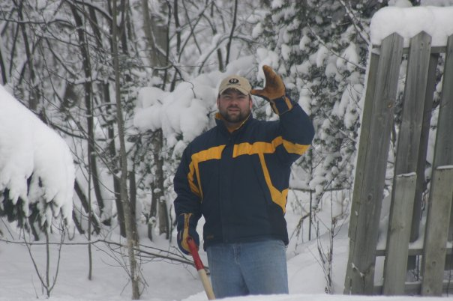
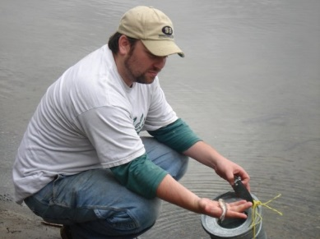
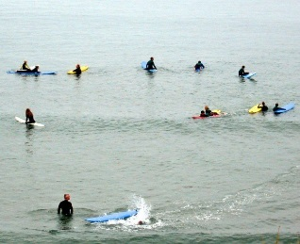
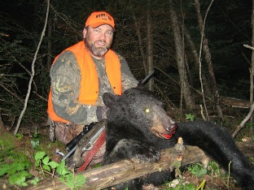
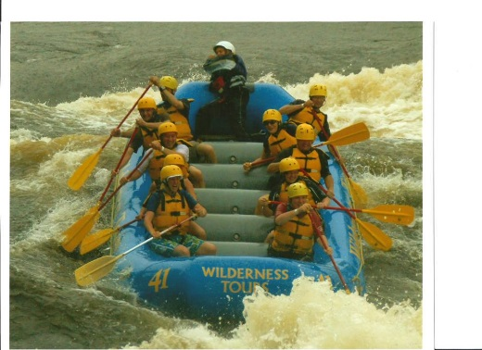
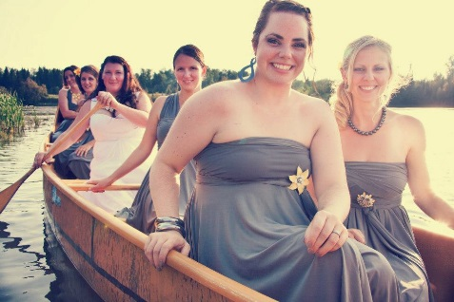
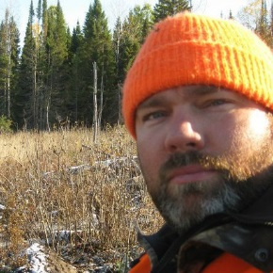
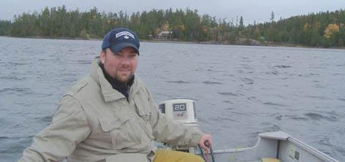
Meet Your Instructors
Mrs. Olaveson (PAD3O)
Mr. Clark (IDC3O)

Slide 7
We are here because…
We enjoy:
Personal Challenges
Being outside
Trying and Failing/Succeeding at new things
Leaving our comfort zone
Working with others
Problem-solving

Slide 8
Why are you here?

Slide 9
Who will do well here?
People who love being out of the school
People who have a positive attitude
People with good attendance
People who can be independent thinkers
People who work well on a team
People who are here because they want to be

Slide 10
Who SHOULD NOT COME BACK Tuesday!?
Today should be your last day if….
You are a fragile athlete
You are here only because your friend is here
You are selfish and treat people poorly
You are late, absent, or skip classes often
You do not have, or can not borrow, appropriate clothing/equipment for the activities

Slide 11
To be successful here you MUST
Dress for the weather. We WILL go out in rain, sleet, and snow; “There are no bad weather days, only bad clothing choices.”
Treat each other well
Come with a positive attitude

Slide 12
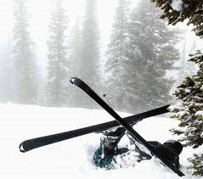
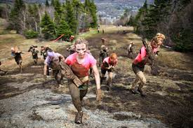
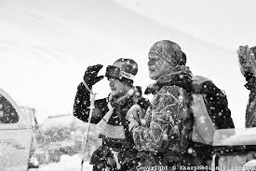
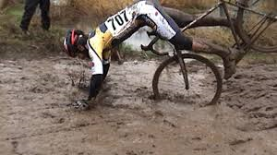
You WILL get wet, dirty and be miserable on some days!

Slide 13
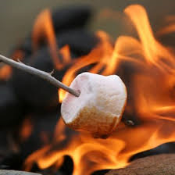
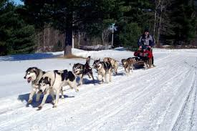
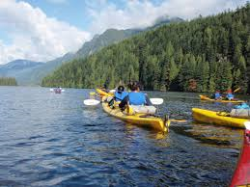
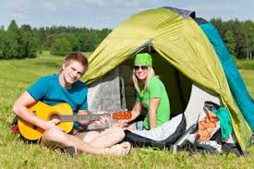
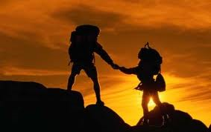
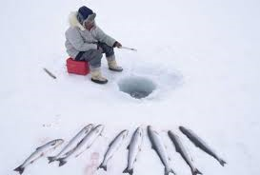
The GOOD days make it all worth while…

Slide 14
If you are not excited by what you see…
PLEASE DROP THIS CLASS!
It is your CHOICE!
Take Responsibility!

